Slide 1
CS217 lecturer: NDN coding tutorial
Yanbiao Li, Haitao Zhang
April 19, 2018

Slide 2
Outline
Warm up
NDN packets and communication model
What do we need to play with NDN?
Analysis of sample code
Step-by-step coding
Prerequisites
A simple consumer
A consumer with timeout retransmission
A simple producer

Slide 3
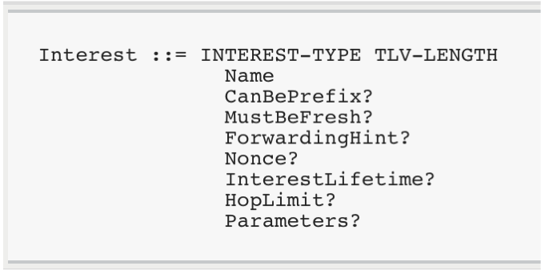
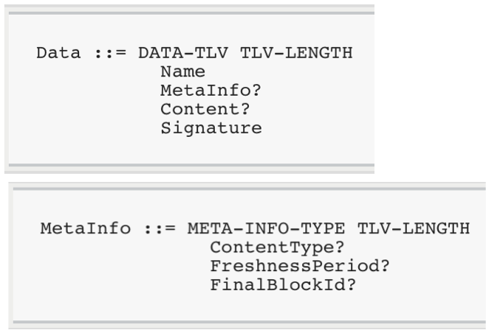
NDN packets and communication model

Slide 4
Play with NDN
Code applications based on ndn-cxx library
ndn-cxx library provides the interfaces to use NDN
e.g., register prefixes, make and transmit NDN packets, etc.
compile the code and link with linndn-cxx
CFLAGS: `pkg-config --cflags libndn-cxx`
LIBS: `pkg-config --libs libndn-cxx`
Run applications with NFD running
NFD: the forwarding daemon that moves NDN packets from their incoming faces to outgoing faces determined by forwarding tables.

Slide 5
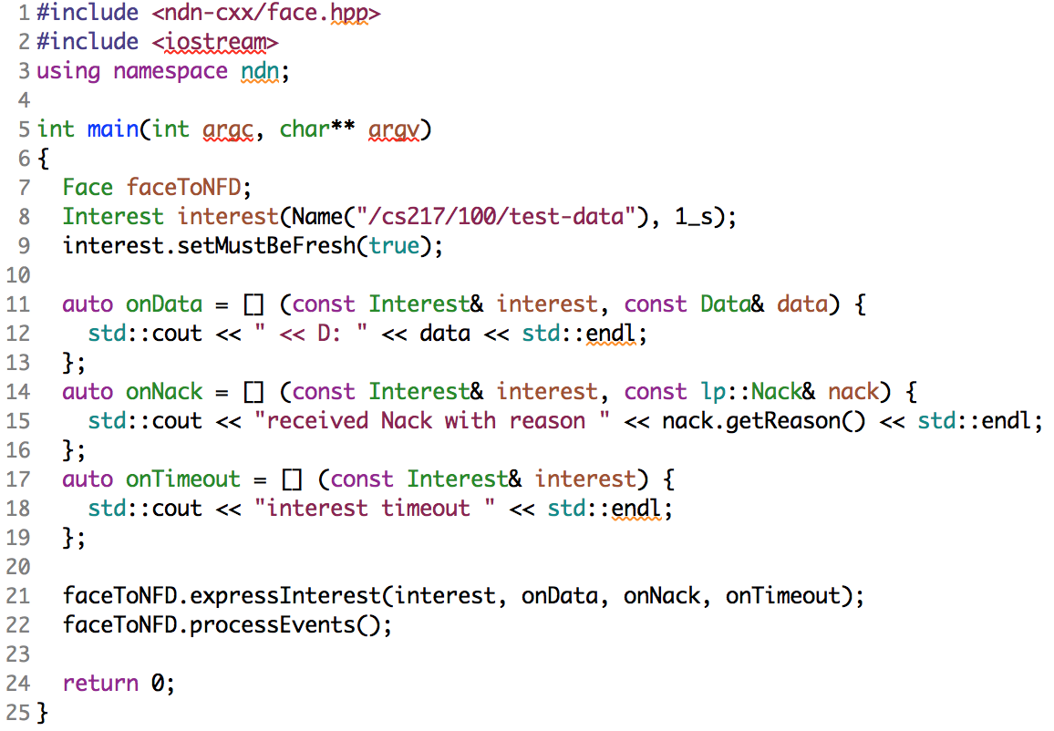
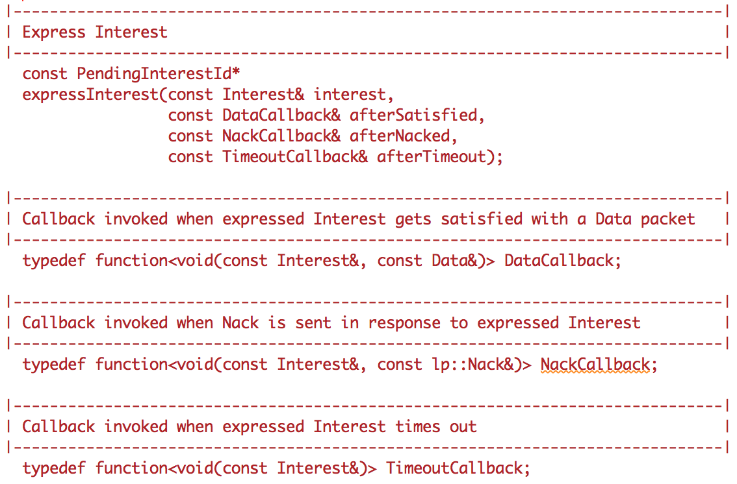
Analysis of sample code
Consumer

Slide 6
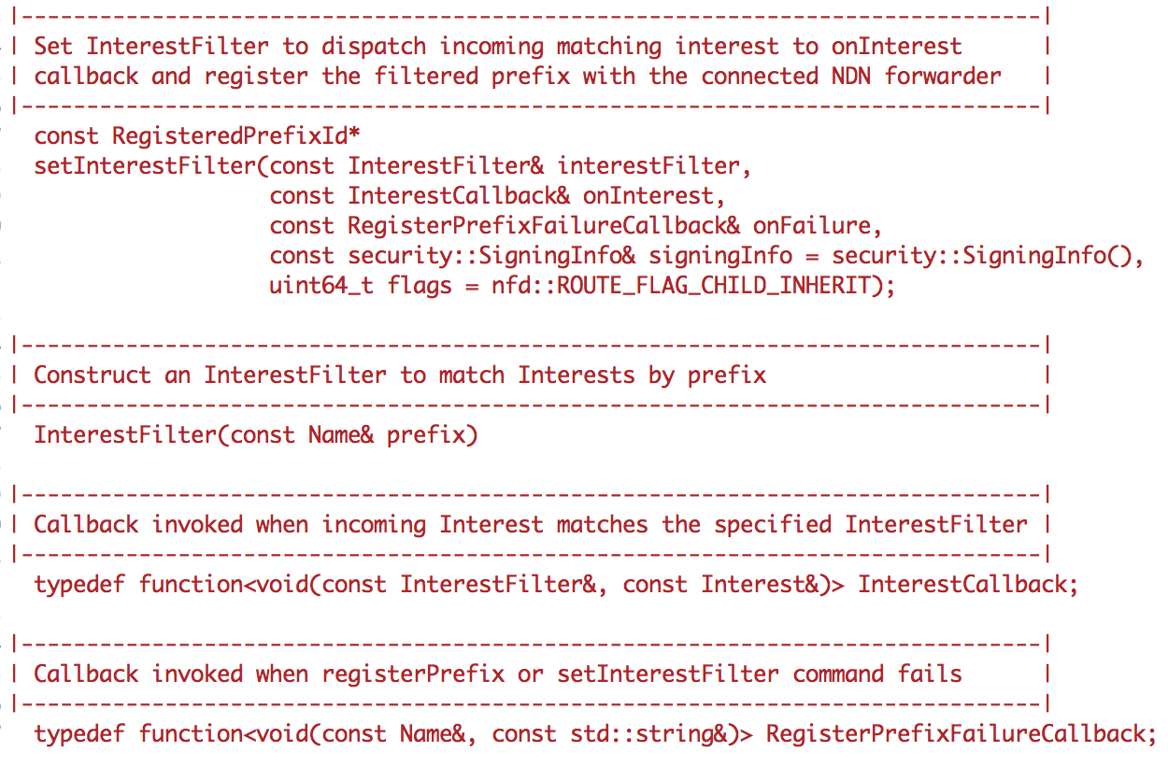
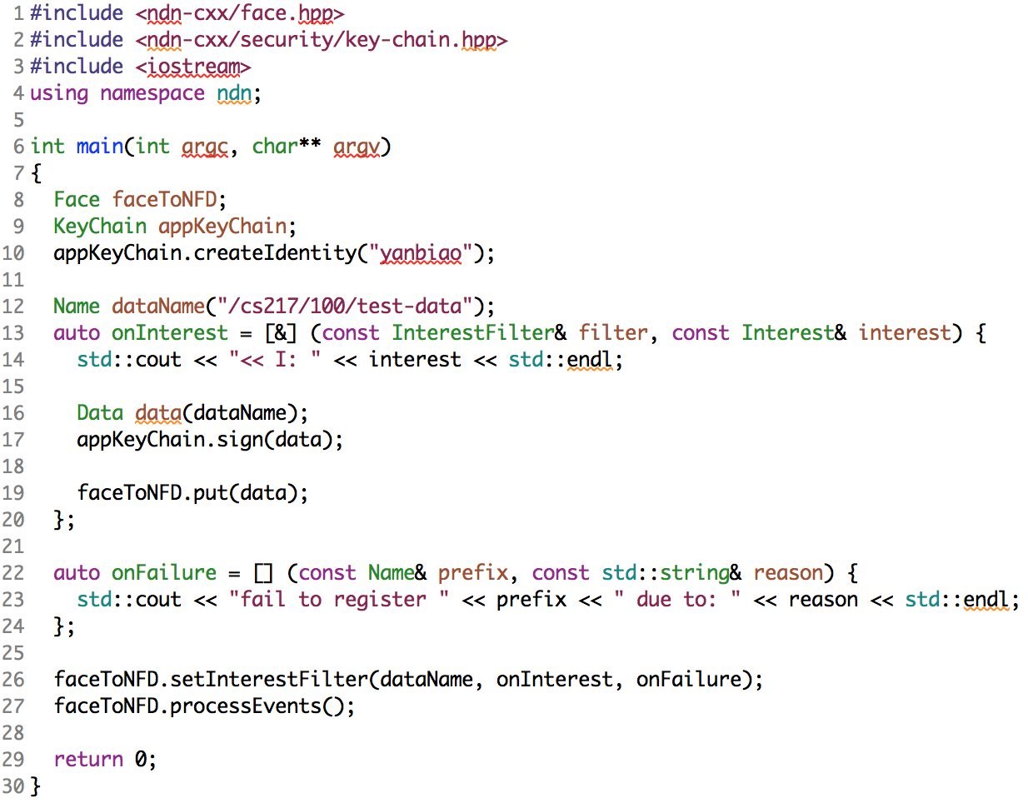
Analysis of sample code
Producer

Slide 7
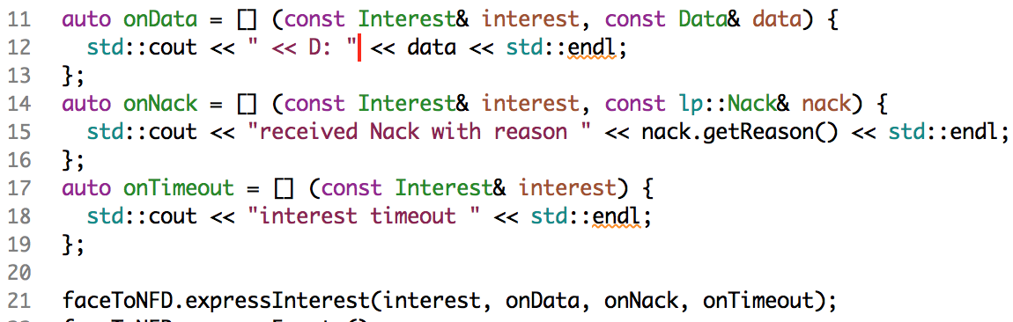
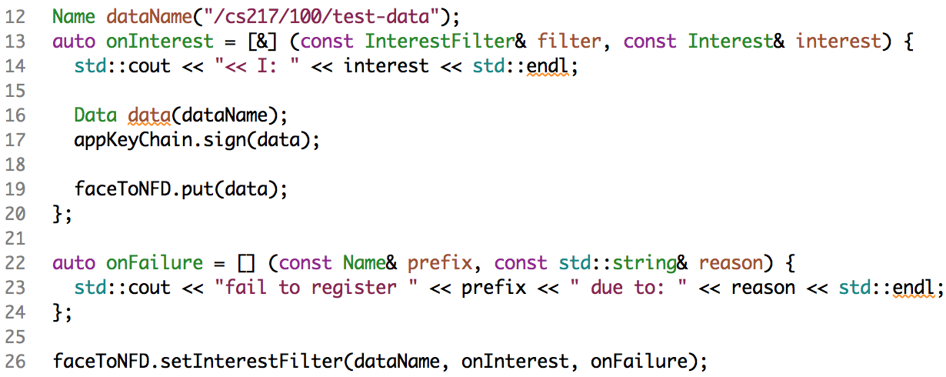
Analysis of sample code
Communication

Slide 8
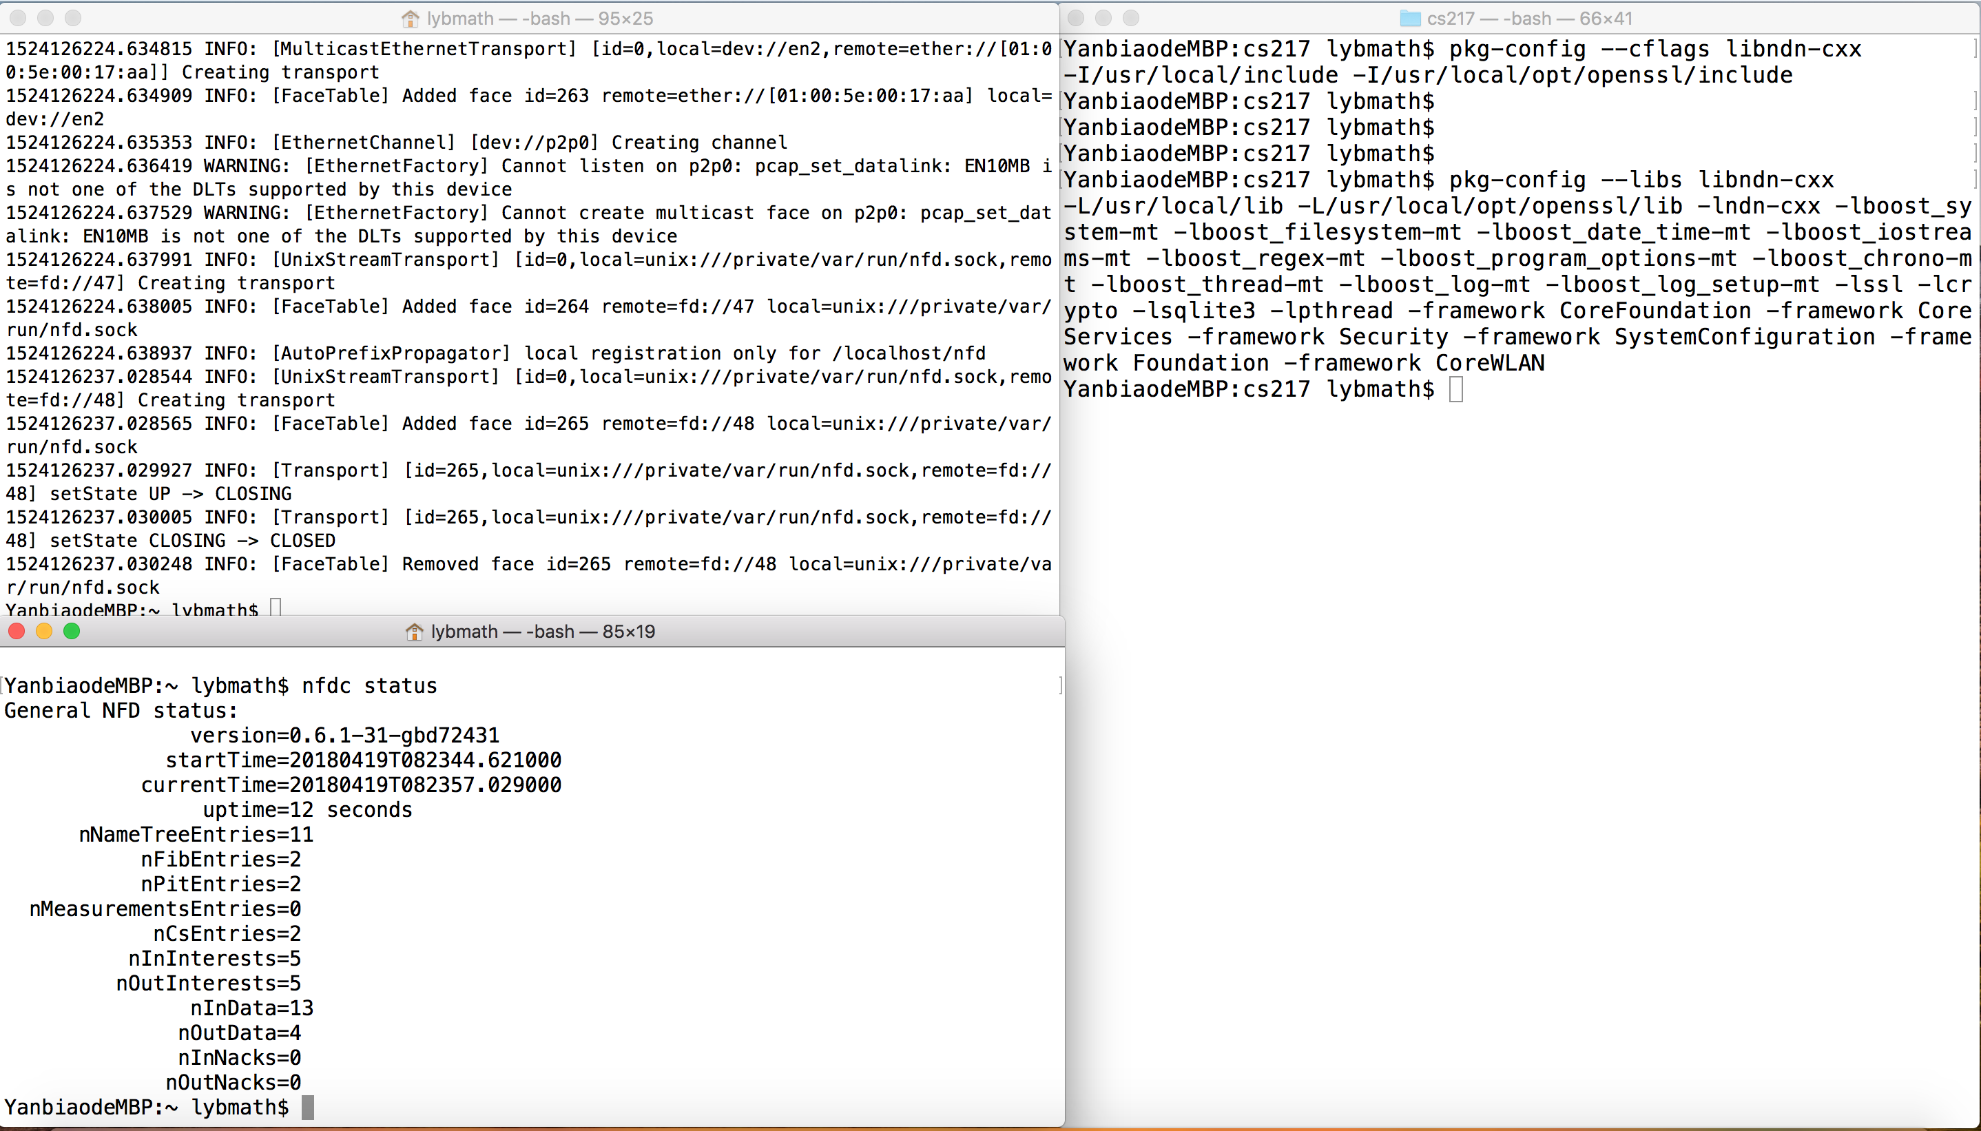
Environment
ssid=cs217, pwd=12345678

Slide 9
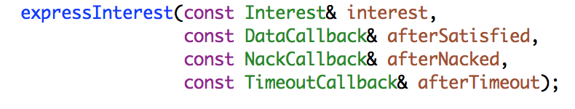
A simple consumer
Requirements
Make and express Interest with name: /cs217/100/test-data
Output information of all cases (onData, onNack, onTimeout)
Hints
Make Interest: ndn-cxx/src/interest.hpp
Express Interest: ndn-cxx/src/face.hpp
Get NACK reason: ndn-cxx/src/lp/nack.hpp

Slide 10
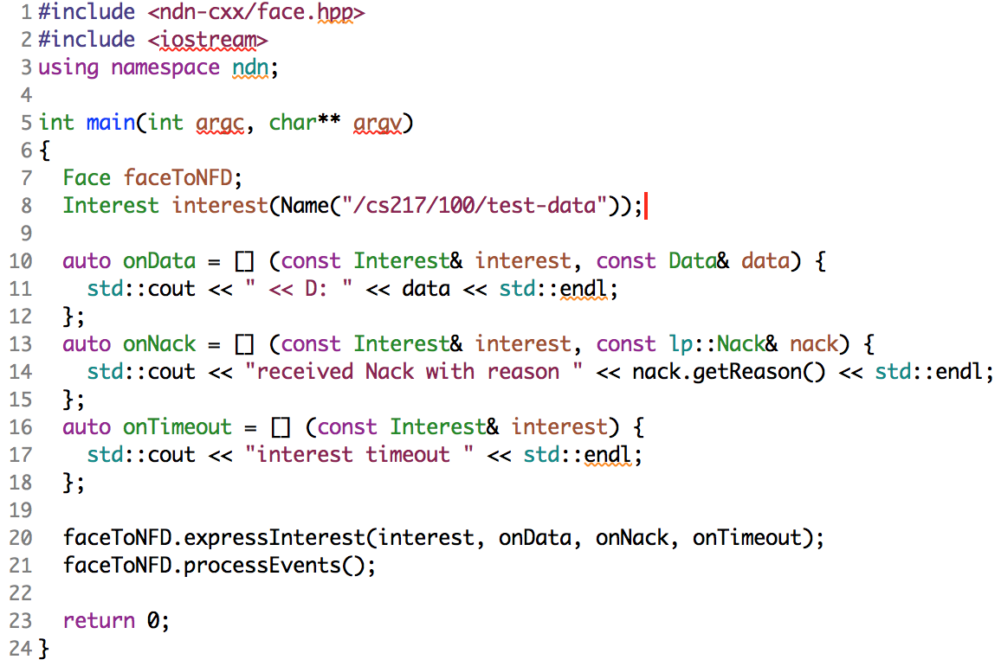
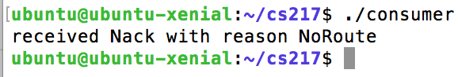
A simple consumer
Code & expected result

Slide 11
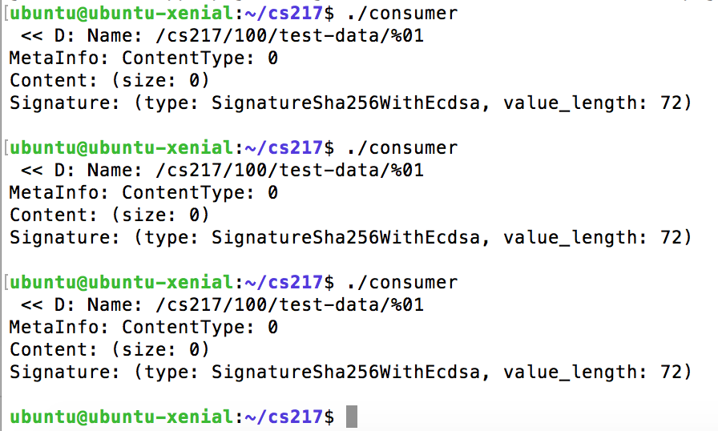
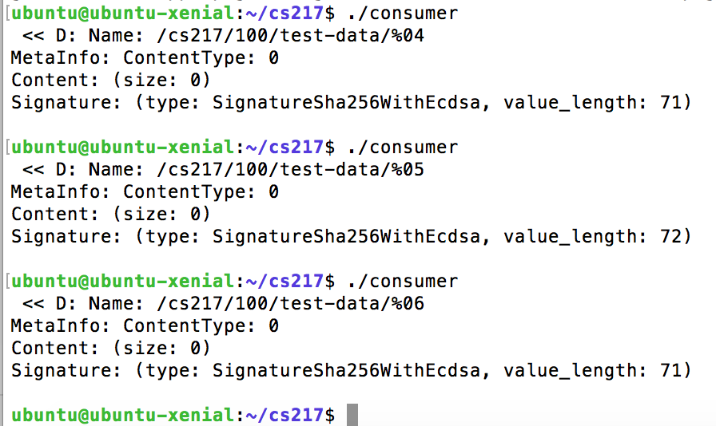
A simple consumer
Route configuration
Requirements
Use nfdc to create an UDP face toward 192.168.0.100
Use nfdc to add a route on the face just created with prefix /cs217/100
Test the effect of Interest setting: MustBeFresh

Slide 12
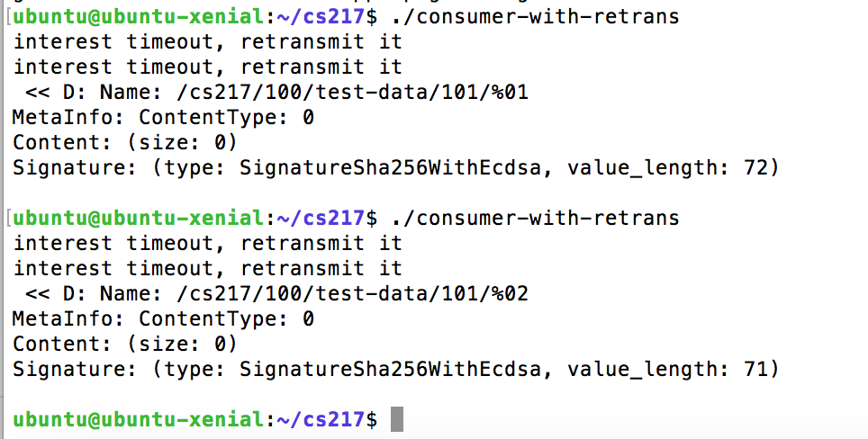
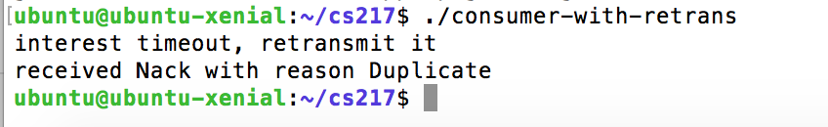
Consumer with retransmission on TimeOut
Requirements
Express Interest with name: /cs217/100/test-data/[last block of your ip]
Retransmit the Interest with the same name on TimeOut
Hints
In case you want to use the function onTimeOut inside itself

Slide 13
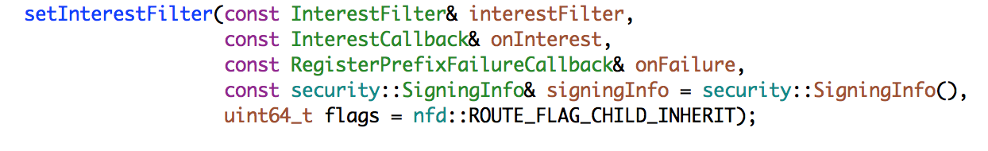
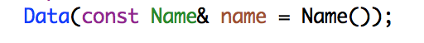
A simple producer
Requirements
Set interest filter: /cs217/[the last block of your ip]/test-data
Run nfdc fib list to check whether the prefix is successfully registered
Make Data and sign it with your identity: /cs217/[the last block of your ip]
Hints
Set interest filter: ndn-cxx/src/face.hpp
Make Data: ndn-cxx/src/data.hpp
Sign Data: ndn-cxx/src/security/v2/data.hpp
Create identity: ndn-cxx/src/security/v2/data.hpp

Slide 14
Thank You !

